Slide 1
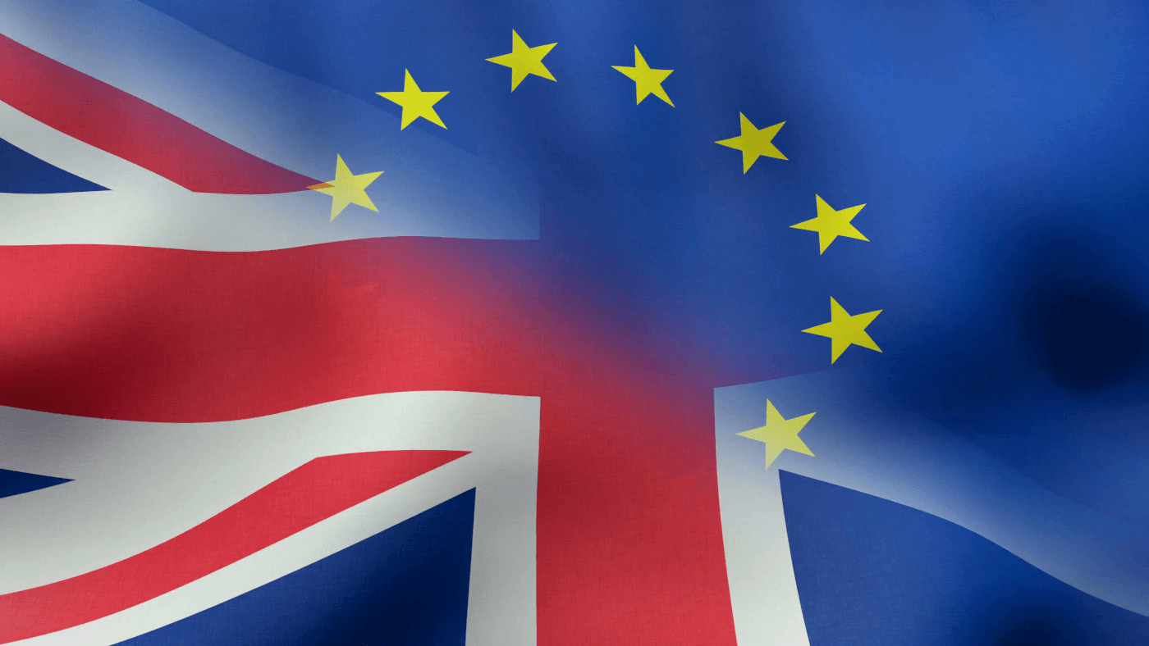
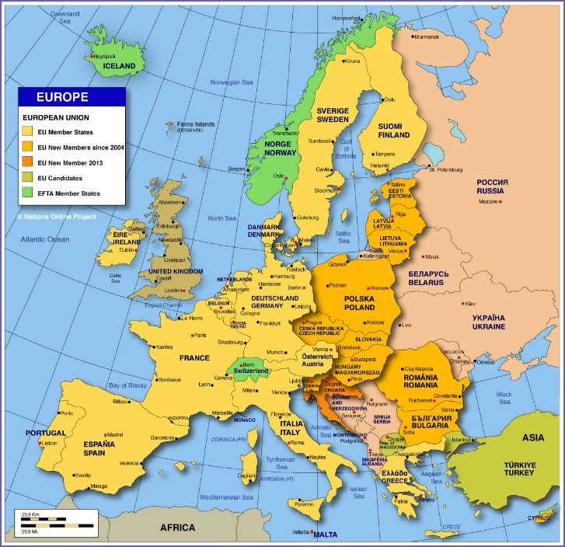
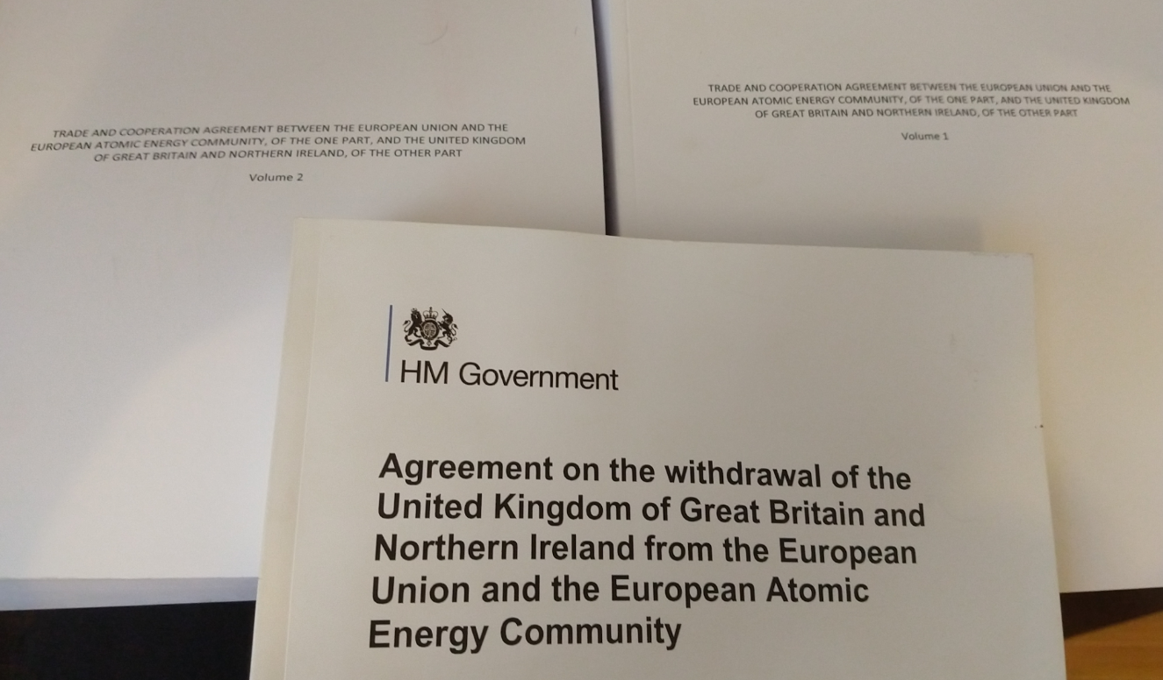
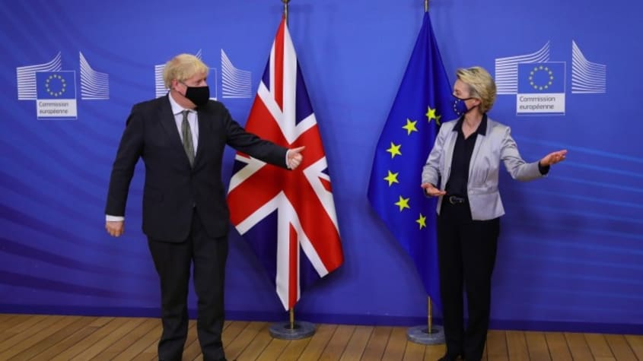
FIW Trade Talk
Brexit and the future of EU-UK trade relations

Slide 2
Four slides
About Me
Nature of modern trade relations
UK-EU trade agreements and modern trade relations
Possible next steps and UK economic adjustment
Bigger trade picture in the context of UK-EU relations
Director, UK Trade Policy Project, European Centre for International Political Economy
Current research interests future UK trade policy, the new global trade, regulations and trade, new issues in trade such as climate change, animal welfare, and consumers
Between 2009 and 2018 worked for UK government on TTIP, establishment of trade department after Brexit, US-China relations, better regulation
Writes on international trade including new weekly column for Borderlex

Slide 3
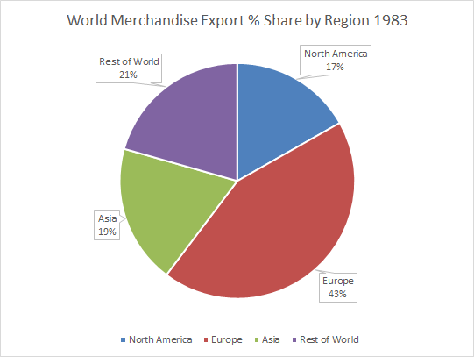
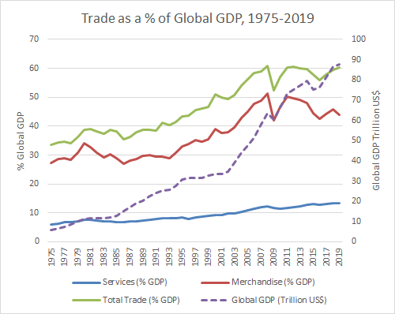
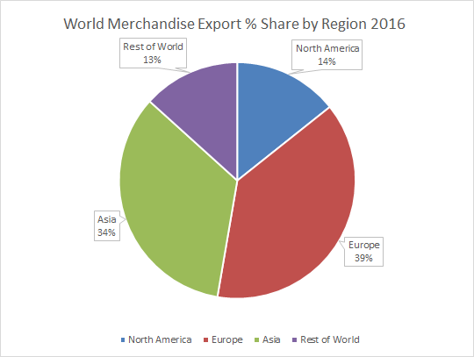
Modern Trade Relationships
Trade has grown, goods in particular from 1990 – 2008, services steadily since early 2000s
Global Value Chains account for anywhere between 50 and 80% of trade according to calculation
Three main regional supply chains, North America, Europe, East and Southeast Asia, dominate global trade
The web of relationships between major producers (in goods and services) and their suppliers is increasingly complex and poorly understood
Virtually all trade is in some way regulated, products and services subject to regulation, plus general societal regulations

Slide 4
UK-EU Agreements (Withdrawal Agreement, Trade and Cooperation Agreement)
Different Agreements
Withdrawal Agreement covers Northern Ireland – EU / GB relations, plus geographical indications
Trade and Cooperation Agreement covers trade plus related areas included transport, energy
Separate future agreements are possible e.g. mutual recognition
Goods
No tariffs subject to rules of origin
Only bilateral cumulation – bad for complex supply chains
Limited easing of regulatory checks – full food and drink checks, minor easing of checks in industrial areas
General regulatory cooperation
UK withdrawal from European regulatory agencies
Regulatory cooperation elements of TCA limited, new agreement on financial services due by March
Data and financial services equivalence – incentive for UK not to diverge to gain this
European neighbourhood
UK does not join PEM rules of origin
Limitations of UK-EU TCA also limits scope of UK agreements with Norway, Switzerland, Turkey
Services
Considerable barriers to services trade compared to single market
No mutual recognition of professional qualification
No long term data equivalence
Barriers to movement of people
Rules
The strictest rules ever seen in a trade agreement on labour and the environment – enforceable non-regression and divergence clauses
Potential penalties for future denial of access to UK fishing waters

Slide 5
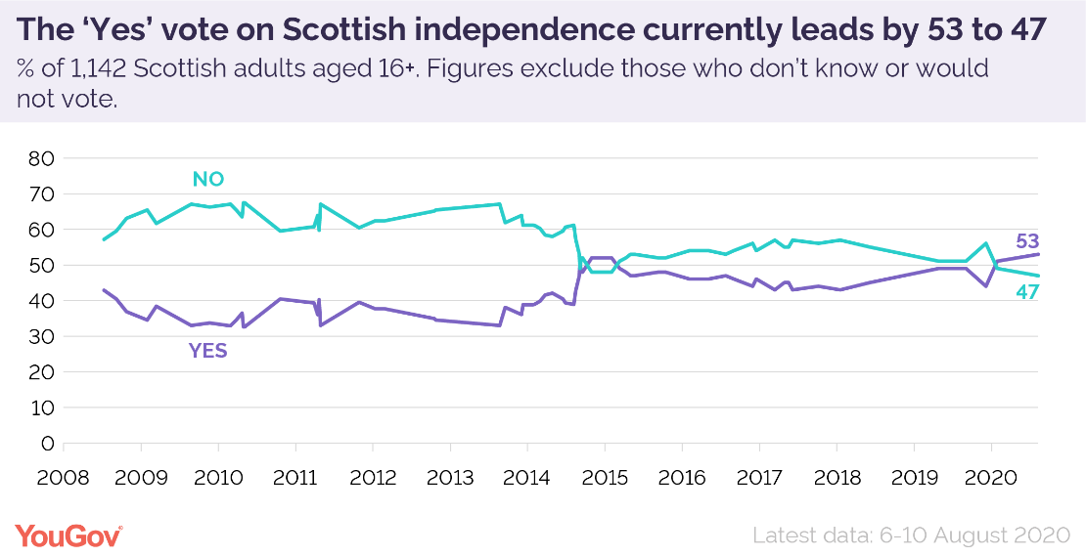
Possible Next Steps and UK Economic Adjustment
Economic Adjustment
UK-EU goods trade already flat since referendum
Does it decline? Does services trade follow?
Impact on Rest of the World trade? For example if UK no longer significantly part of European supply chain for goods
Services figures may be exaggerated by US trade?
Covid effect
Likeliest outcome – trade flat or falling for a period
Politics
Politics of Northern Ireland and Scotland
Business pressure on UK government not to diverge versus Brexiteer pressure for ‘Brexit dividend’
Labour Party not currently proposing closer relationship – no significant change for some years
Economic and human cost of barriers
Possible trade deals with US and CPTPP taking UK further away from EU rule-set

Slide 6
What does the UK-EU deal mean for the wider trade context?
European supply chains are weakened with EU-UK barriers. For example fragmentation of the services market in the EU away from London is likely to lead to an overall loss of competitiveness.
EU-US relations are risked by a UK-US agreement which takes the US position on long running disputes include agriculture and technical standards.
Climate change and labour provisions may become a precedent for other agreements, which may cause issues with agreement, or for Mercosur signed but not yet ratified, in this passing through Parliament. If UK, EU and US could work together on future climate change measures there may be a more positive precedent.
Question of future regulatory alignment likely to affect future discussions starting with data and financial services, then moving onto other areas including veterinary equivalence, professional qualifications, mutual recognition of professional qualifications. How do both sides address this? To what extent will either side wish to use enforcement measures?
UK as competition for the EU, to what extent does this incentivise both sides to innovate further? This could potentially be a positive effect.
Ability of UK and EU to work together at the WTO still to be tested, important for resolving issues there.

