Slide 1
Ethnic diversity and the labour market integration of immigrants
Thomas Horvath, Peter Huber,
FIW Workshop, WIFO

Slide 2
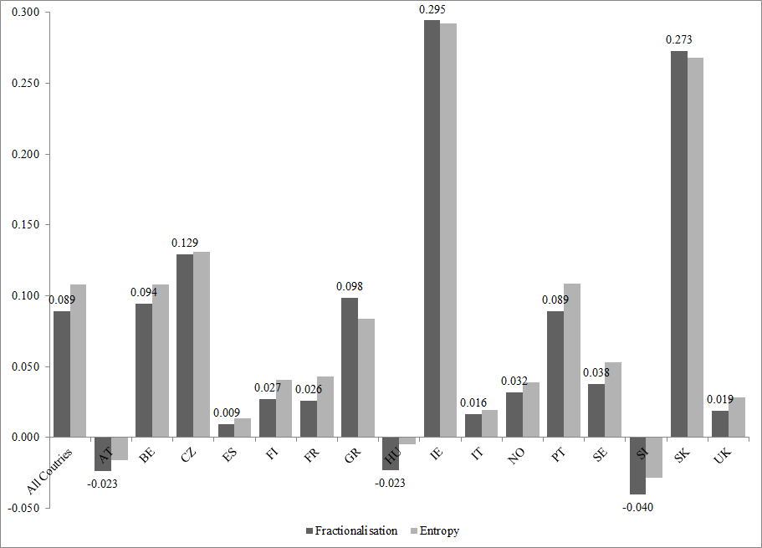
Diversity of foreign born
(increase 2004 -2011)

Slide 3
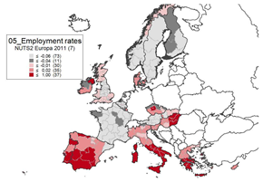
Employment rate differential native – foreign born

Slide 4
Literature on economic effects of ethnic diversity
Theory:
benefits in production may arise if workers from different cultures present different complementary skills and abilities => increase of productivity.
costs may be increased co-ordination costs among different groups and loss of trust potentially resulting from increased ethnic diversity => loss of productivity.
Empiricis
Productivity - Ottaviano and Peri 2005, 2006, Ratna et al. 2009, Sparber 2010, Dohse and Gold 2014
Growth - Easterly and Levine 1997
Employment and wages of natives - Suedekum et al. 2014, Bellini et al. 2008, Nathan 2011, Ottaviano and Peri 2005, 2006
Innovation, entrepreneurship, workplace satisfaction - Niebuhr 2010, Audretsch et al. 2010, Longhi 2011
Recent results on regional level indicate a positive impact of diversity on regional development due to increase in labour productivity. Literature pertaining to the national level often finds a negative impact of ethnic diversity on productivity.
Our contribution – impact on labour market integration of foreign born.

Slide 5
Literature on regional demographics and labour market outcomes of immigrants
Theory
Networks and ethnic segregation may foster contacts among immigrants => facilitates job matching and labour market integration
May also reduce incentives to invest in host country specific human capital (language) => may reduce (long term) integration prospects
Empirics
Segregation : empirical literature so far (mostly concerned with the US) has remained rather inconclusive (Cutler et al. 2008)
  Early studies => negative impact of segregation (e.g. Cutler and Glaeser 1997)
  Later studies => no relationship or a reversed relationship (e.g. Collins and Margo, 2000)
  Quasi experimental evidence => positive effects (Piil Damm, 2009, Edin et al 2003)
Networks: Quite few studies showing positive effects of share of own group in a region (e.g.Patel and Vella 2007, Toussaint-Comeau 2008) or frequency of actual contacts on labour market integration.
  Some results suggesting that networks lead to integration into social benefits and lower language learning (Chiswick and Miller 2002, Pohjola, 1991, Bertrand et al. 1998).
  Also many extensions: contacts to natives may be more valuable than contacts to immigrants (Kanas et al. 2012), quality of network may matter…
=> Our contribution: ethnic diversity of a region may be a further variable impacting on employment and unemployment probabilities among immigrants

Slide 6
Contribution
Central Question:
What is the impact of ethnic diversity on labour market integration of immigrants?
Differentiate:
By education groups
For recent and established
Results
Robust positive average impact of ethnic diversity on employment probabilities of both recent as well as established immigrants,
Employment prospects of highly educated recent immigrants improve more than those of less educated recent immigrants as ethnic diversity increases :
Outline:
Theory:
Data:
Results
Conclusions

Slide 7
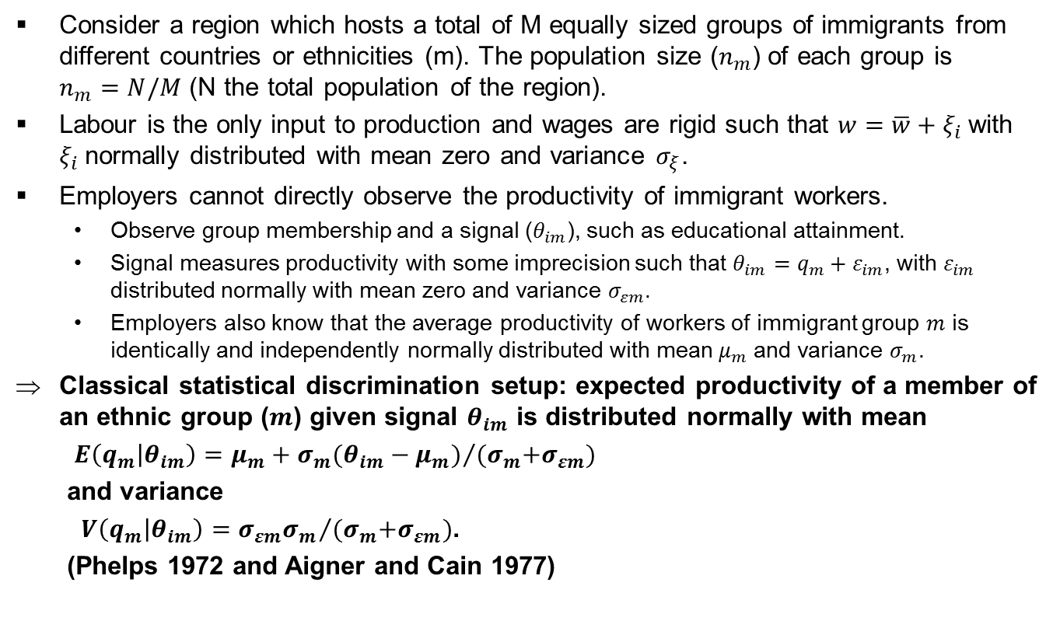
Theory: Why are immigrants different?
Consider a region which hosts a total of M equally sized groups of immigrants from different countries or ethnicities (m). The population size ($n_{m}$) of each group is $n_{m}=N/M$ (N the total population of the region).
Labour is the only input to production and wages are rigid such that $w=\overline{w}+ξ_{i}$with $ξ_{i}$normally distributed with mean zero and variance $σ_{ξ}$.
Employers cannot directly observe the productivity of immigrant workers.
  Observe group membership and a signal ($θ_{im}$), such as educational attainment.
  Signal measures productivity with some imprecision such that $θ_{im}=q_{m}+ε_{im}$, with $ε_{im}$ distributed normally with mean zero and variance $σ_{εm}$.
  Employers also know that the average productivity of workers of immigrant group $m$ is identically and independently normally distributed with mean $μ_{m}$ and variance $σ_{m}$.
Classical statistical discrimination setup: expected productivity of a member of an ethnic group ($m$) given signal $θ_{im}$ is distributed normally with mean
$E\left(q_{m} | θ_{im}\right)=μ_{m}+{σ_{m}(θ_{im}−μ_{m})}/{{(σ}_{m}+σ_{εm}})$
and variance
$V\left(q_{m} | θ_{im}\right)={σ_{εm}σ_{m}}/{{(σ}_{m}+σ_{εm})}$.
(Phelps 1972 and Aigner and Cain 1977)

Slide 8

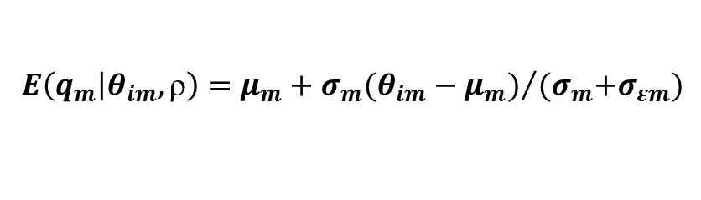
Theory: Effects of ethnic Diversity
Expected
Productivity
$$E\left(q_{m} | θ_{im},\right)$$
Signal
$E\left(q_{m} | θ_{im},\right)=μ_{m}+{σ_{m}(θ_{im}−μ_{m})}/{{(σ}_{m}+σ_{εm}})$

Slide 9
Empirical questions
What is aggregate effect of diversity on labour market integration?
Dominance of signal noise or heterogeneity of immigrants (i.e. more or less positiive effects on more highly educated)?
More relevant for imigrant groups where information level is lower (i.e. recent versus established immigrants)?

Slide 10
Method
We estimate linear probability model
and
Separately for recent established immigrants
  Where
  y = measure of immigrant labour market integration (individual level)
  ρ = diversity
  L,M,H = indicator education level
  X = individual level controls
  Z = region specific controls (regional e.g. unemployment rate)
  π = sending country fixed effect
  μ = sending country fixed effect
  τ = time fixed effect
  Note: Standard errors all clustered on region year
Q1
Q2
Q3

Slide 11
Method issues
Missing variables:
  As pointed out by Bertrand et al (1998) using data from more than one time period that allows for controlling for region of residence, sending country and time fixed effects should do away with many of the missing variable problems that plague standard cross-sectional analyses on this topic.
Endogeneity (Dujardin and Goffette-Nagot 2010)
  quasi experimental techniques or using of sibling data => we do not have the necessary data
  sample restriction = focusing on a group of persons that is unlikely to have had a choice in their original location decision. E.g. persons who moved to a particular country as children and whose location decision was therefore taken for them by their parents = leads to too few observations
  => We use Instrumental variables => two suggested and used in literature (Cutler, 2000, Betrand et al. 2008)
    Prediction of values based on country and sending groups specific occupation structure
    Prediction of values based on country and sending groups specific sector structure

Slide 12
Data
ELFS from 2004 to 2011
  representative survey conducted in all EU27-countries and Norway
  asks respondents on their country of birth and (if born abroad) on their duration of stay in the respective country.
  Provides information on NUTS2 level in most countries (NUTS1 in Austria).
  Contains
    demographic characteristics (age, gender, marital status number of children and many others),
    labour market status (employed, unemployed and inactive) according to ILO definitions,
    Can differentiate only between 8 country groups of sending region
    Provides annual duration of residence for p to 10 years only
Caveats
  German LFS does not ask the question of country of birth and in some countries (in particular EU10) samples of foreign born to small to allow for meaningful analysis.
  Also some countries only one Nuts 2 region (creates problem with instrument)
  We end up with 15 EU countries (Austria, Belgium, Czech Republic, Finland, France, Greece, Hungary, Italy, Ireland, Slovakia, Portugal, Slovenia, Spain, Sweden, UK) and Norway

Slide 13
Dependent variables & definitions
Dependent variable
  Employment = 1 if foreign born is employed acording to ILO definition, 0 else
  Unemployment = 1 if foreign born is unemployed acording to ILO definition 0 if employed else
Definition
  Foreigner= foreign born
Sample Split (Dictated by data)
  Recent immigrant = in country of residence for 10 or less years
  Established immigrant = in country of residence for more than10

Slide 14
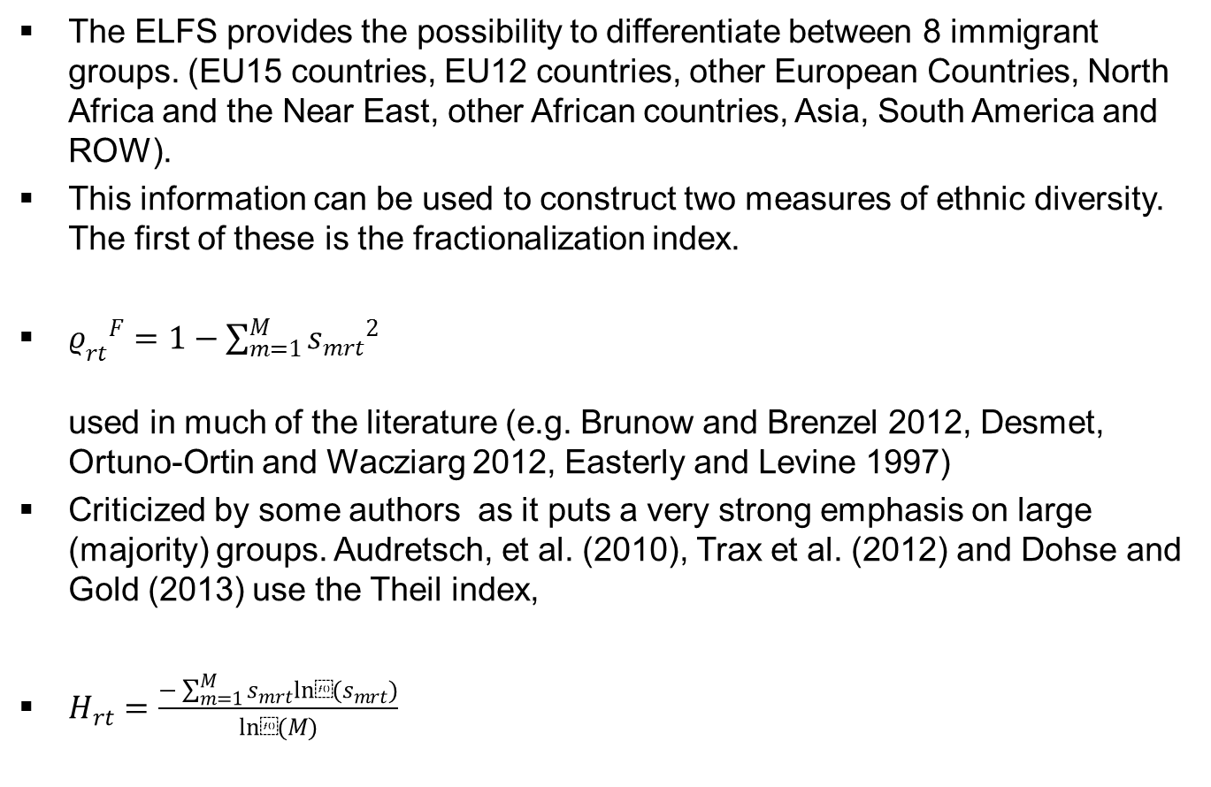
Measuring diversity
The ELFS provides the possibility to differentiate between 8 immigrant groups. (EU15 countries, EU12 countries, other European Countries, North Africa and the Near East, other African countries, Asia, South America and ROW).
This information can be used to construct two measures of ethnic diversity. The first of these is the fractionalization index.
${ρ_{rt}}^{F}=1−\sum_{m=1}^{M}{{s_{mrt}}^{2}}$
used in much of the literature (e.g. Brunow and Brenzel 2012, Desmet, Ortuno-Ortin and Wacziarg 2012, Easterly and Levine 1997)
Criticized by some authors as it puts a very strong emphasis on large (majority) groups. Audretsch, et al. (2010), Trax et al. (2012) and Dohse and Gold (2013) use the Theil index,
$H_{rt}=\frac{−\sum_{m=1}^{M}{s_{mrt}ln⁡(s_{mrt}})}{ln⁡(M)}$

Slide 15
Controls
Control variables
  Share of same ethnicity immigrants in same region
  10 Age dummies
  Gender
  Marital status
  Education
  National employment/ unemployment rate
  Years of resdinence
  Citizenship
  Region fixed effects
  Sending Country fixed effects
  Year fixed effects

Slide 16
Descriptives

Slide 17
Results: Overall Recent

Slide 18
Results: Education groups recent immigrants

Slide 19
Results: Established Immigrants

Slide 20
Summary
Robust positive average impact of ethnic diversity on employment probabilities of both recent as well as established immigrants,
After instrumenting, ethnic diversity has a positive impact on the employment probability of the least skilled recent and established immigrants.
  => positive effects of ethnic diversity on average productivity also found in earlier studies on natives are strong enough to compensate for any negative effects of increased heterogeneity on low educated immigrants.
Employment prospects of highly educated recent immigrants improve more than those of less educated recent immigrants as ethnic diversity increases.
  dominance of immigrants heterogeneity effect over signal noise effect.
No evidence of such a differential impact of ethnic diversity on employment probabilities for established migrants
  => information problems with respect to the productivity of immigrant workers due to increased diversity are less severe.

Slide 21
Conclusions
Differences in effects on different skill groups remain statistically insignificant for the unemployment risks of both established and recent immigrants
For established immigrants ethnic diversity is an altogether insignificant determinant of their unemployment risk.
  => Suggests some labour supply side reaction of immigrants in more diverse regions that may be focus of future research.
Results are robust across a number of specifications and to measuring diversity by both the fractionalisation index and the Theil index,
  .

Slide 22
Thank you for your attention

